Slide 1
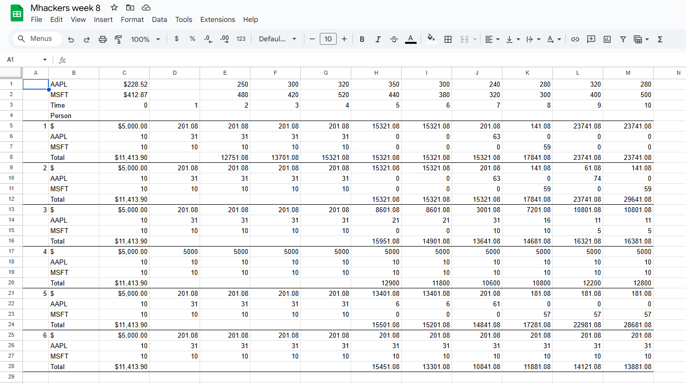

Quant
2024-2025

Slide 2
Attendance
https://tinyurl.com/bdh59ws9
https://forms.gle/pnb7DKNJjRtz2xJB8

